Slide 1
“Criticism…Again?”
John Staiger
For Morningside Church of Christ
Sunday 3 May 2020
PM Sermon
Broadcast at 6pm on Facebook Live
From 16 McClintock Road, Massey, Auckland.

Slide 2
Welcome
Sunday 3 May 2020
Morningside Church of Christ
(42 Leslie Ave, Sandringham, Auckland)
Facebook Live
11am
6pm
Wednesday at 7pm

Slide 3
Criticism…Again?

Slide 4
Always going to be those—

Slide 5
Always going to be those—
Professional complainers
Burdened down with hurt to share
Sinners reflecting their guilt
Who just-don’t-care how you feel
Selfishly looking to take advantage
Who think they’re funny
Are poor communicators
We just don’t get
Who are genuine, but misguided…

Slide 6
Always going to be those—
Professional complainers
Burdened down with hurt to share
Sinners reflecting their guilt
Who just-don’t-care how you feel
Selfishly looking to take advantage
Who think they’re funny
Are poor communicators
We just don’t get
Who are genuine, but misguided…

Slide 7
Always going to be those—
Professional complainers
Burdened down with hurt to share
Sinners reflecting their guilt
Who just-don’t-care how you feel
Selfishly looking to take advantage
Who think they’re funny
Are poor communicators
We just don’t get
Who are genuine, but misguided…

Slide 8
Always going to be those—
Professional complainers
Burdened down with hurt to share
Sinners reflecting their guilt
Who just-don’t-care how you feel
Selfishly looking to take advantage
Who think they’re funny
Are poor communicators
We just don’t get
Who are genuine, but misguided…

Slide 9
Always going to be those—
Professional complainers
Burdened down with hurt to share
Sinners reflecting their guilt
Who just-don’t-care how you feel
Selfishly looking to take advantage
Who think they’re funny
Are poor communicators
We just don’t get
Who are genuine, but misguided…

Slide 10
Always going to be those—
Professional complainers
Burdened down with hurt to share
Sinners reflecting their guilt
Who just-don’t-care how you feel
Selfishly looking to take advantage
Who think they’re funny
Are poor communicators
We just don’t get
Who are genuine, but misguided…

Slide 11
Always going to be those—
Professional complainers
Burdened down with hurt to share
Sinners reflecting their guilt
Who just-don’t-care how you feel
Selfishly looking to take advantage
Who think they’re funny
Are poor communicators
We just don’t get
Who are genuine, but misguided…

Slide 12
Always going to be those—
Professional complainers
Burdened down with hurt to share
Sinners reflecting their guilt
Who just-don’t-care how you feel
Selfishly looking to take advantage
Who think they’re funny
Are poor communicators
We just don’t get
Who are genuine, but misguided…

Slide 13
Always going to be those—
Professional complainers
Burdened down with hurt to share
Sinners reflecting their guilt
Who just-don’t-care how you feel
Selfishly looking to take advantage
Who think they’re funny
Are poor communicators
We just don’t get
Who are genuine, but misguided…

Slide 14
Before
Criticism
Comes your way

Slide 15

It pays to learn to laugh at yourself

Slide 16
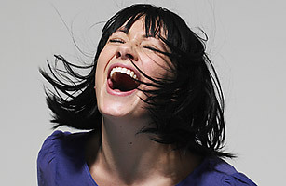
Yes, even when you feel that the joke is at your expense.
Yes, it means you should laugh it off.
And, yes, even if it means that you must set things in order.

Slide 17
Yes, even when you feel that the joke is at your expense.
Yes, it means you should laugh it off.
And, yes, even if it means that you must set things in order.

Slide 18
Yes, even when you feel that the joke is at your expense.
Yes, it means you should laugh it off.
And, yes, even if it means that you must set things in order.

Slide 19
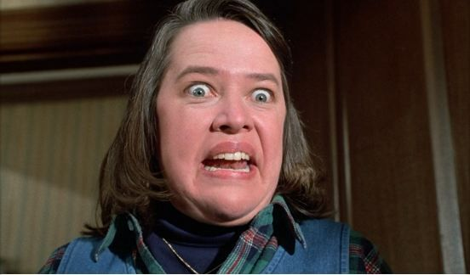
Sharing misery is not your most attract side.

Slide 20
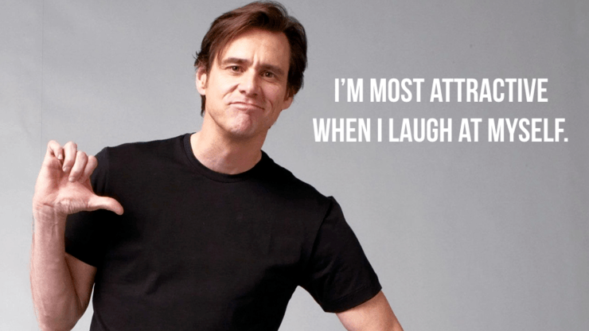
You look your best:
When:
You become expert at admitting your shortcomings
Galatians 6:4—But each one must examine his own work, (NASB95)

Slide 21
You look your best:
When:
You become expert at admitting your shortcomings
Galatians 6:4—But each one must examine his own work, (NASB95)

Slide 22
You look your best:
When:
Humility knocks you down a peg-or-two
1 Peter 5:6—Therefore humble yourselves under the mighty hand of God, that He may exalt you at the proper time, (NASB95)

Slide 23
You look your best:
When:
Humility knocks you down a peg-or-two
1 Peter 5:6—Therefore humble yourselves under the mighty hand of God, that He may exalt you at the proper time, (NASB95)

Slide 24
You look your best:
When:
You move on to be a better disciple.

Slide 25
We all
  Imagine
  Think
  Say
  …and Do
dumb things!

Slide 26
Criticism
Will Come
Your way

Slide 27
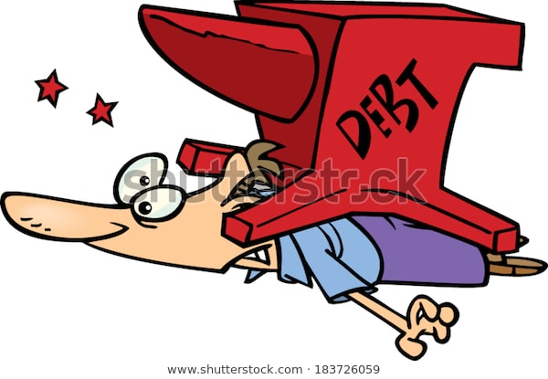
But what about the
HEAVY CRITICISM
HEAVY
CRITICISM

Slide 28
But what about the
HEAVY CRITICISM
What must you do when someone is:
  Running you down?
  Lying to you?
  Lying about you?
  Blaming you?
  Backstabbing you?
How hard is it to have a good attitude toward them?

Slide 29
But what about the
HEAVY CRITICISM
What must you do when someone is:
  Running you down?
  Lying to you?
  Lying about you?
  Blaming you?
  Backstabbing you?
How hard is it to have a good attitude toward them?

Slide 30
But what about the
HEAVY CRITICISM
What must you do when someone is:
  Running you down?
  Lying to you?
  Lying about you?
  Blaming you?
  Backstabbing you?
How hard is it to have a good attitude toward them?

Slide 31
But what about the
HEAVY CRITICISM
What must you do when someone is:
  Running you down?
  Lying to you?
  Lying about you?
  Blaming you?
  Backstabbing you?
How hard is it to have a good attitude toward them?

Slide 32
But what about the
HEAVY CRITICISM
What must you do when someone is:
  Running you down?
  Lying to you?
  Lying about you?
  Blaming you?
  Backstabbing you?
How hard is it to have a good attitude toward them?

Slide 33
But what about the
HEAVY CRITICISM
What must you do when someone is:
  Running you down?
  Lying to you?
  Lying about you?
  Blaming you?
  Backstabbing you?
How hard is it to have a good attitude toward them?

Slide 34
But what about the
HEAVY CRITICISM
What must you do when someone is:
  Running you down?
  Lying to you?
  Lying about you?
  Blaming you?
  Backstabbing you?
How hard is it to have a good attitude toward them?

Slide 35
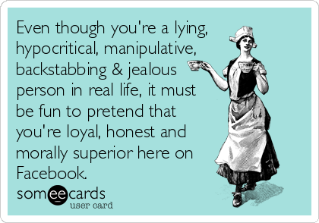

Slide 36
Forms of criticism…
1. Blame
2. Condemnation
3. Protest
4. Destructive behaviour
5. Silence
6. Withholding of payment
7. Boycott

Slide 37
Forms of criticism…
1. Blame
2. Condemnation
3. Protest
4. Destructive behaviour
5. Silence
6. Withholding of payment
7. Boycott

Slide 38
Forms of criticism…
1. Blame
2. Condemnation
3. Protest
4. Destructive behaviour
5. Silence
6. Withholding of payment
7. Boycott

Slide 39
Forms of criticism…
1. Blame
2. Condemnation
3. Protest
4. Destructive behaviour
5. Silence
6. Withholding of payment
7. Boycott

Slide 40
Forms of criticism…
1. Blame
2. Condemnation
3. Protest
4. Destructive behaviour
5. Silence
6. Withholding of payment
7. Boycott

Slide 41
Forms of criticism…
1. Blame
2. Condemnation
3. Protest
4. Destructive behaviour
5. Silence
6. Withholding of payment
7. Boycott

Slide 42
Forms of criticism…
1. Blame
2. Condemnation
3. Protest
4. Destructive behaviour
5. Silence
6. Withholding of payment
7. Boycott

Slide 43
Forms of criticism…
1. Blame
2. Condemnation
3. Protest
4. Destructive behaviour
5. Silence
6. Withholding of payment
7. Boycott

Slide 44
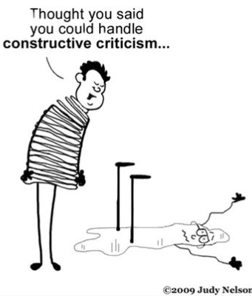
But what about the
HEAVY CRITICISM

Slide 45
Criticism
Best
Defeated
Through
Resilience

Slide 46

Resilience
It’s a group activity
We need Support
Perspective
Critique
Assurance

Slide 47
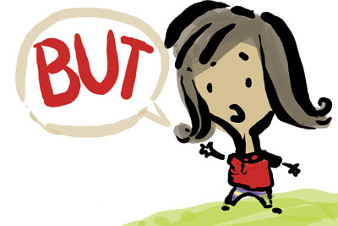
Resilience
It’s a group activity

Slide 48

Resilience
It’s a group activity

Slide 49

Resilience
It’s a group activity
We need Support
Perspective
Critique
Assurance
Proverbs 11:14—
Where there is no guidance the people fall,
But in abundance of counselors there is victory. (NASB95)

Slide 50
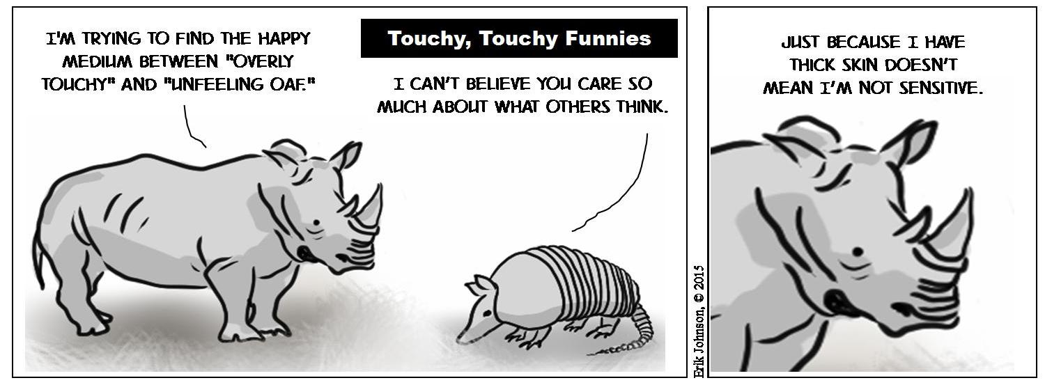
Resilience
Thin skin is not an option

Slide 51

Resilience
Thin skin is not an option
Lose that hyper-sensitivity
Sober minded
Standing firm
Ready for battle
Resisting evil
Get rid of the
The
Syndrome

Slide 52
Resilience
Thin skin is not an option
Lose that hyper-sensitivity
Thick skin doesn’t mean a hard heart.
1 Thessalonians 5:14—
“…encourage the fainthearted, help the weak, be patient with everyone. (NASB95)

Slide 53

Resilience
You don’t have time to waste feeling sorry for yourself.
Ephesians 5:16—making the most of your time, because the days are evil. (NASB95)

Slide 54
Criticism
Things
Common
To all of us

Slide 55

Things in Common
Your words are a wide-open window into your heart.

Slide 56
Things in Common
What you say has eternal consequences…
Matthew 12:36-37
³⁶But I tell you that every careless word that people speak, they shall give an accounting for it in the day of judgment. ³⁷For by your words you will be justified, and by your words you will be condemned.” (NASB)

Slide 57

Things in Common
Reactions are everything…
Your default job—Peacemaker (Mt.5:9)
Your default tone—Gentleness (Pro.15:1)
Your default goal—Forgiveness (Lk.23:34)

