Slide 1
Series: Life in the Son.
Part 3. “Forgiven.”
John Staiger
Morningside Church of Christ
Sunday 10 October 2021
AM Sermon
Broadcast on Facebook Live from
Massey, Auckland, Aotearoa/NZ.

Slide 2
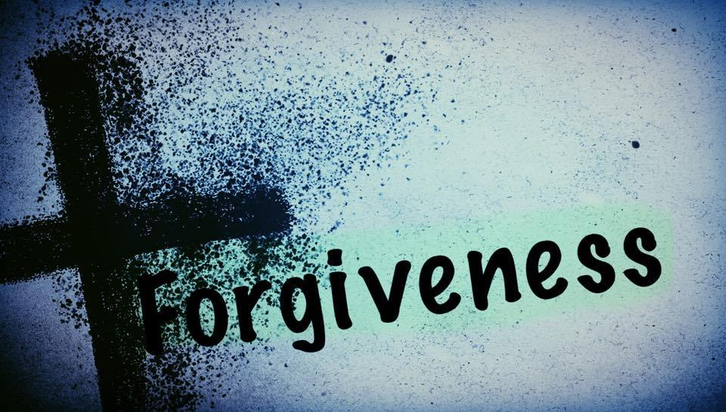
Life in the Son.
3. Forgiven…

Slide 3
Starting point for those in Christ…

Slide 5
Romans 8:1—Therefore there is now no condemnation for those who are in Christ Jesus.

Slide 6
So, if you are a Christian—

Slide 7
So, if you are a Christian—
Rejoice!!!

Slide 8
John 8:36—
³⁶So if the Son makes you free, you will be free indeed.

Slide 9
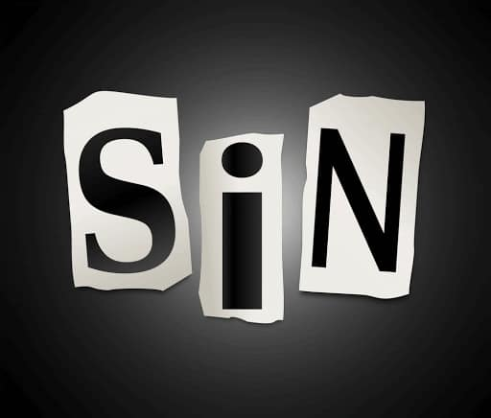
Forgiveness—
Sin gets in the way.
Isaiah 59:1-2—

Slide 10
Forgiveness—
Sin gets in the way.
Isaiah 59:1-2—
Behold, the Lord’s hand is not so short That it cannot save; Nor is His ear so dull That it cannot hear. ²But your iniquities have made a separation between you and your God, And your sins have hidden His face from you so that He does not hear. (NASB95)

Slide 11
Forgiveness—
Sin gets in the way.
Isaiah 59:1-2— ²But your iniquities have made a separation between you and your God, And your sins have hidden His face from you so that He does not hear. (NASB95)

Slide 12
Forgiveness—
Sin gets in the way.

Slide 13
Forgiveness—
Sin gets in the way.
Solution—
Run to Jesus…

Slide 14
Forgiveness—
Repent and be saved, or perish.
Acts 2:38—
³⁸Peter said to them, “Repent, and each of you be baptized in the name of Jesus Christ for the forgiveness of your sins; and you will receive the gift of the Holy Spirit. (NASB95)

Slide 15
Forgiveness—
Repent and be saved, or perish.
Acts 2:38—
³⁸Peter said to them, “Repent, and each of you be baptized in the name of Jesus Christ for the forgiveness of your sins; and you will receive the gift of the Holy Spirit. (NASB95)

Slide 16
Forgiveness—
Repent and be saved, or perish.
2 Corinthians 7:10—
¹⁰For the sorrow that is according to the will of God produces a repentance without regret, leading to salvation, but the sorrow of the world produces death. (NASB95)

Slide 17
Forgiveness—
Repent and be saved, or perish.
2 Corinthians 7:10—
¹⁰For the sorrow that is according to the will of God produces a repentance without regret, leading to salvation, but the sorrow of the world produces death. (NASB95)

Slide 18
Forgiveness—
Repent and be saved, or perish.
Luke 18:13—
But the tax collector, standing some distance away, was even unwilling to lift up his eyes to heaven, but was beating his breast, saying, ‘God, be merciful to me, the sinner!’

Slide 19
Forgiveness—
Repent and be saved, or perish.
Luke 18:13—
But the tax collector, standing some distance away, was even unwilling to lift up his eyes to heaven, but was beating his breast, saying, ‘God, be merciful to me, the sinner!’

Slide 20
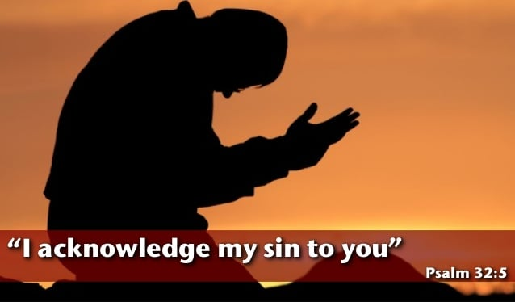
Forgiveness—Sin No More!
Psalm 32:5—
I acknowledged my sin to You,
And my iniquity I did not hide;
I said, “I will confess my transgressions to the Lord”;
And You forgave the guilt of my sin.

Slide 21
Forgiveness—Sin No More!
Jeremiah 31:34—
“for I will forgive their iniquity, and their sin I will remember no more.” (NASB95)

Slide 22
Forgiveness—Sin No More!
Jeremiah 31:34—
“for I will forgive their iniquity, and their sin I will remember no more.” (NASB95)

Slide 23
Forgiveness—Sinlessness gifted humanity.
2 Corinthians 5:21—
He made Him who knew no sin to be sin on our behalf, so that we might become the righteousness of God in Him.

Slide 24
Forgiveness—Sinlessness gifted humanity.
2 Corinthians 5:21—
He made Him who knew no sin to be sin on our behalf, so that we might become the righteousness of God in Him.

Slide 25
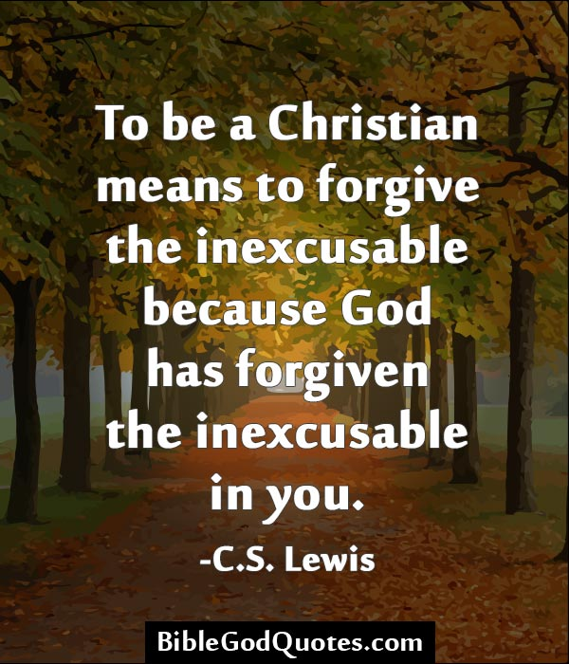

Slide 26
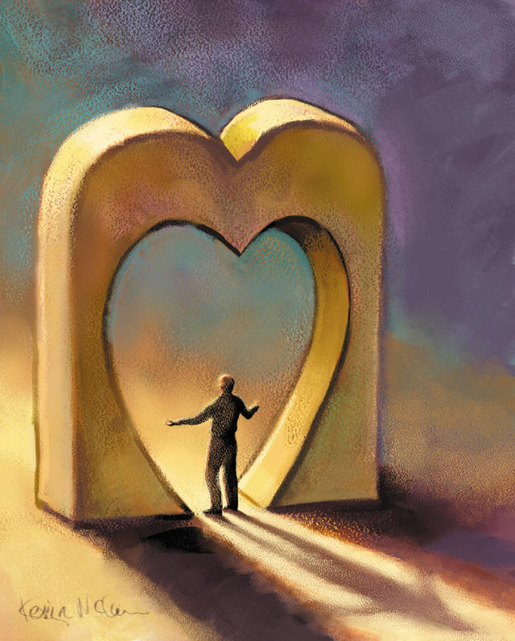
Forgiveness—A Blessing found and shared in Christ.
Ephesians 4:32—Be kind to one another, tender-hearted, forgiving each other, just as God in Christ also has forgiven you.

Slide 27
Forgiveness—A Blessing found and shared in Christ.
Ephesians 4:32—Be kind to one another, tender-hearted, forgiving each other, just as God in Christ also has forgiven you.

Slide 28
“Baptism now saves you” (1Pet.3:21).
²¹Corresponding to that, baptism now saves you—not the removal of dirt from the flesh, but an appeal to God for a good conscience—through the resurrection of Jesus Christ, (NASB95)

