Slide 1
Series: Who in the World are You, Again?
Part 1.
John Staiger
Morningside Church of Christ
Sunday 10 April 2022
PM Sermon
Broadcast live from 42 Leslie Ave, Auckland, Aotearoa/NZ.

Slide 2
Who in the World are You, Again?

Slide 3
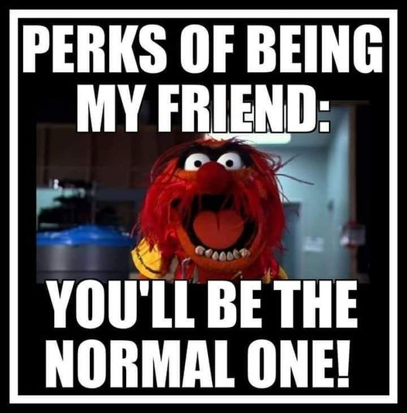
Series: Who in the World are You, Again? Part 1.

Slide 4
Series: Who in the World are You, Again? Part 1.

Slide 5
Series: Who in the World are You, Again? Part 1.
Who are You?

Slide 6
Series: Who in the World are You, Again? Part 1.
Who are You?
Usually more subtly put.
But a very good question.
Points of “Reference” help.
But we also want to make sure of who and what someone is not:
Imposter
Nigerian scammer
We become detectives…

Slide 7
Series: Who in the World are You, Again? Part 1.
Who are You?
Usually more subtly put.
But a very good question.
Points of “Reference” help.
But we also want to make sure of who and what someone is not:
Imposter
Nigerian scammer
We become detectives…

Slide 8
Series: Who in the World are You, Again? Part 1.
Who are You?
Usually more subtly put.
But a necessary question.
Points of “Reference” help.
But we also want to make sure of who and what someone is not:
Imposter
Nigerian scammer
We become detectives

Slide 9
Series: Who in the World are You, Again? Part 1.
Who are You?
Usually more subtly put.
But a very good question.
Points of “Reference” help.
But we also want to make sure of who and what someone is not:
Imposter
Nigerian scammer
We become detectives

Slide 10
Series: Who in the World are You, Again? Part 1.
Who are You?
Usually more subtly put.
But a very good question.
Points of “Reference” help.
But we also want to make sure of who and what someone is not:
Imposter
Nigerian scammer
We become detectives

Slide 11
Series: Who in the World are You, Again? Part 1.
Who are You?
Usually more subtly put.
But a very good question.
Points of “Reference” help.
But we also want to make sure of who and what someone is not:
Imposter
Nigerian scammer
We become detectives

Slide 12
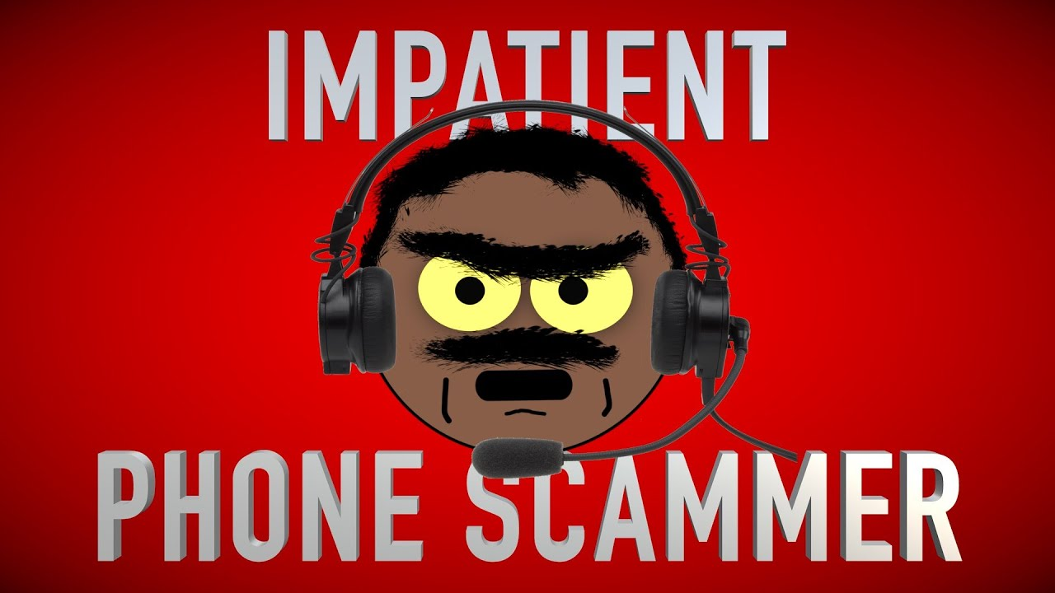
Series: Who in the World are You, Again? Part 1.
Who are You?
Usually more subtly put.
But a very good question.
Points of “Reference” help.
But we also want to make sure of who and what someone is not:
Imposter
Scammer
We become detectives

Slide 13
Series: Who in the World are You, Again? Part 1.
Who are You?
Usually more subtly put.
But a very good question.
Points of “Reference” help.
But we also want to make sure of who and what someone is not:
Imposter
Scammer
We become detectives…

Slide 14
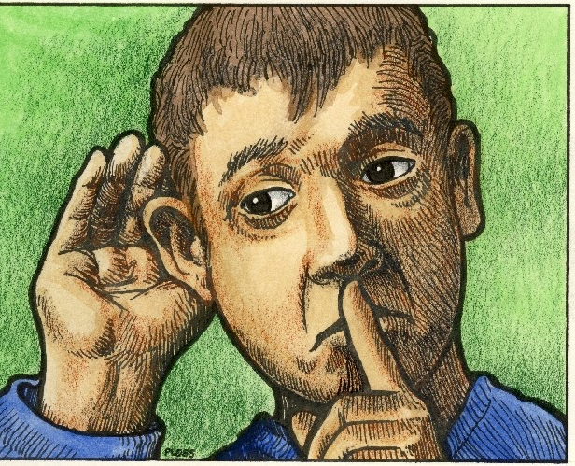
Series: Who in the World are You, Again? Part 1.
Who are You?

Slide 15
Series: Who in the World are You, Again? Part 1.
Who are You?

Slide 16
Series: Who in the World are You, Again? Part 1.
Who in the World are you?

Slide 17
Series: Who in the World are You, Again? Part 1.
Who in the World are you?
It’s not “Who” in the world are we?
It’s “WHOSE” in the world are we?
Members of a spiritual household.
Family of God.
Chosen people.
God’s own possession.

Slide 18
Series: Who in the World are You, Again? Part 1.
Who in the World are you?
It’s not “Who” in the world are we?
It’s “WHOSE” in the world are we?
Members of a spiritual household.
Family of God.
Chosen people.
God’s own possession.

Slide 19
Series: Who in the World are You, Again? Part 1.
Who in the World are you?
It’s not “Who” in the world are we?
It’s “WHOSE” in the world are we?
Members of a spiritual household.
Family of God.
Chosen people.
God’s own possession.

Slide 20
Series: Who in the World are You, Again? Part 1.
Who in the World are you?
It’s not “Who” in the world are we?
It’s “WHOSE” in the world are we?
Members of a spiritual household.
Family of God.
Chosen people.
God’s own possession.

Slide 21
Series: Who in the World are You, Again? Part 1.
Who in the World are you?
It’s not “Who” in the world are we?
It’s “WHOSE” in the world are we?
Members of a spiritual household.
Family of God.
Chosen people.
God’s own possession.

Slide 22
Series: Who in the World are You, Again? Part 1.
Who in the World are you?
It’s not “Who” in the world are we?
It’s “WHOSE” in the world are we?
Members of a spiritual household.
Family of God.
Chosen people.
God’s own possession.

Slide 23
Series: Who in the World are You, Again? Part 1.
A Better Place to be…
Hebrews 11:16
¹⁶But as it is, they desire a better country, that is, a heavenly one. Therefore God is not ^{[a]}ashamed to be called their God; for He has prepared a city for them. (NASB) [a]Lit ashamed of them, to be

Slide 24
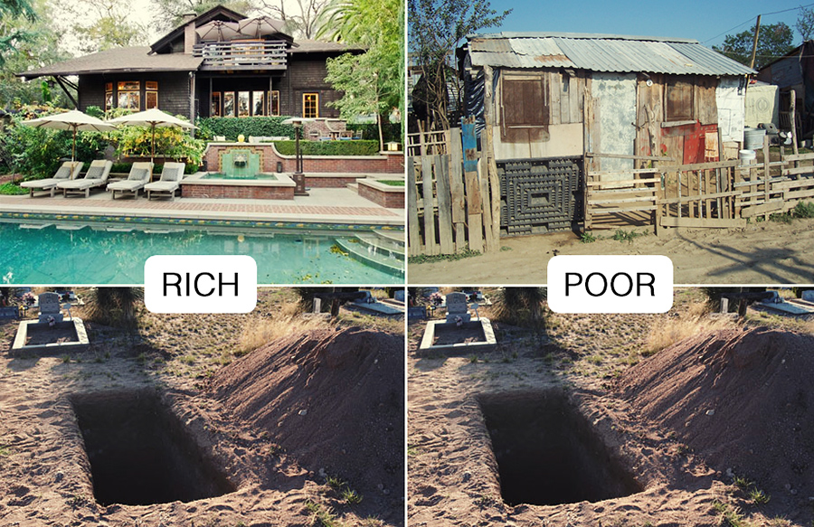
Series: Who in the World are You, Again? Part 1.
A Better Place to be…

Slide 25
Series: Who in the World are You, Again? Part 1.
A Better Place to be…

Slide 26
Series: Who in the World are You, Again? Part 1.
What in the world are we?
1 Peter 2:11
¹¹Beloved, I urge you as aliens and strangers to abstain from fleshly lusts which wage war against the soul. (NASB)

Slide 27
Series: Who in the World are You, Again? Part 1.
What in the world are we?
In this World we are simply:
Sojourners
Exiles
Strangers
Lest we fall asleep spiritually and forget where we are.

Slide 28
Series: Who in the World are You, Again? Part 1.
What in the world are we?
In this World we are simply:
Sojourners
Exiles
Strangers
Lest we fall asleep spiritually and forget where we are.

Slide 29
Series: Who in the World are You, Again? Part 1.
What in the world are we?
In this World we are simply:
Sojourners
Exiles
Strangers
Lest we fall asleep spiritually and forget where we are.

Slide 30
Series: Who in the World are You, Again? Part 1.
What in the world are we?
In this World we are simply:
Sojourners
Exiles
Strangers
Lest we fall asleep spiritually and forget where we are.

Slide 31
Series: Who in the World are You, Again? Part 1.
What in the world are we?
In this World we are simply:
Sojourners
Exiles
Strangers
Lest we fall asleep spiritually and forget where we are.

Slide 32
Series: Who in the World are You, Again? Part 1.
What are we getting caught up in…?

Slide 33
Series: Who in the World are You, Again? Part 1.
What are we getting caught up in…?
That keeps our investments in this world?
What “desire of your heart” are you looking after?
What “lie” are you living?
What “passion” are you pursuing?

Slide 34
Series: Who in the World are You, Again? Part 1.
What are we getting caught up in…?
That keeps our investments in this world?
What “desire of your heart” are you looking after?
What “lie” are you living?
What “passion” are you pursuing?

Slide 35
Series: Who in the World are You, Again? Part 1.
What are we getting caught up in…?
That keeps our investments in this world?
What “desire of your heart” are you looking after?
What “lie” are you living?
What “passion” are you pursuing?

Slide 36
Series: Who in the World are You, Again? Part 1.
What are we getting caught up in…?
That keeps our investments in this world?
What “desire of your heart” are you looking after?
What “lie” are you living?
What “passion” are you pursuing?

